Slide 1



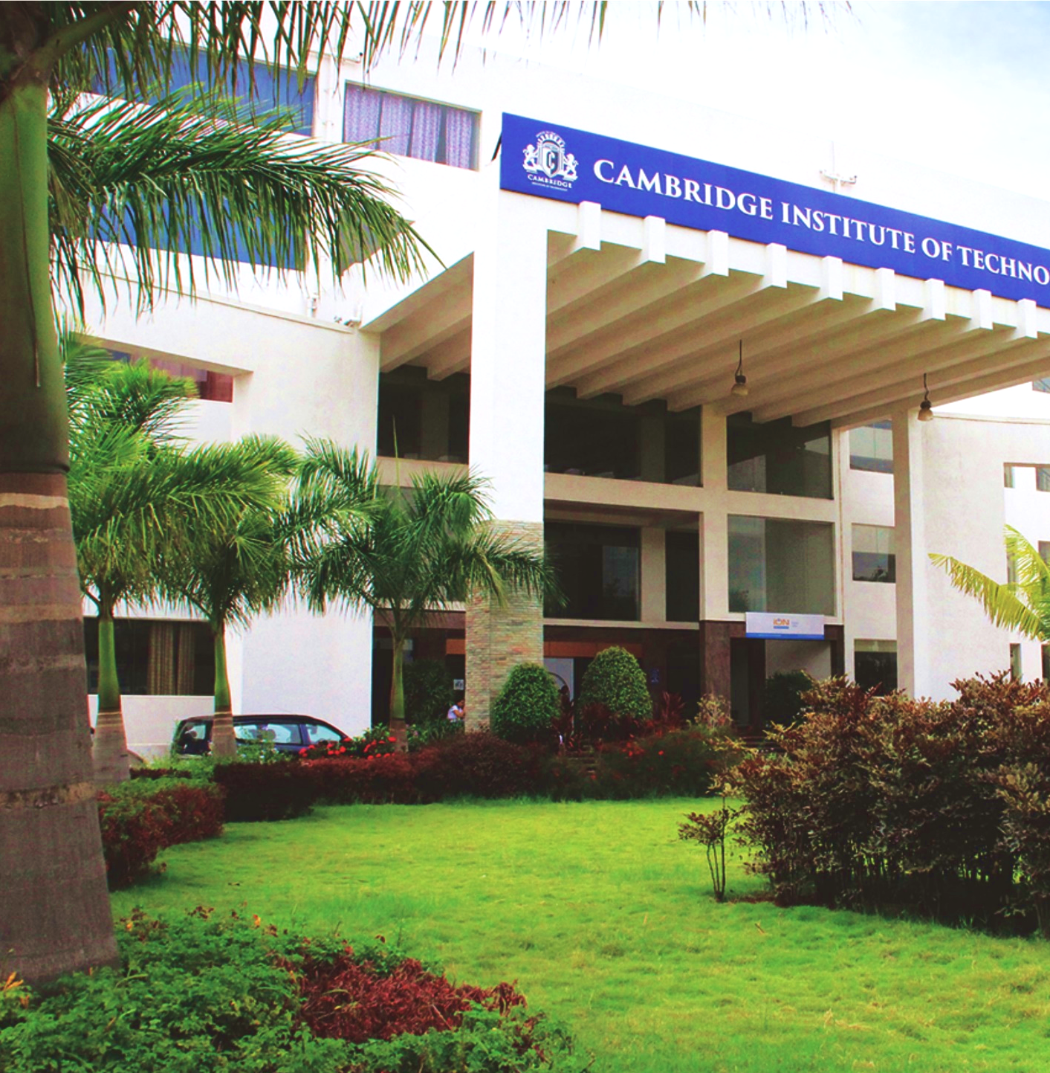
Department of
Information Science & Engineering
Project Review – 1
Title : Cybersecurity Framework for Secure Patient Data Transmission in Healthcare Networks
Batch No. - 52
Akshitha J (1CD23IS006)
JayaBhargavi D (1CD23IS061)
Chandana R (1CD23IS032)
Under the guidance of:
Prof. Asma Taj
ISE department.
www.cambridge.edu.in

Slide 2


ABSTRACT
In The “Secure Health” system is a Django-based healthcare platform designed to protect sensitive patient data using role-based access control , OTP-based authentication, biometric authentication(face recognition system) and emergency access. It ensures secure login using biometric authentication , controlled file sharing, and prevents unauthorized access through one-time OTP verification. The system also supports automated PDF report generation and email notifications, improving efficiency and data security. Overall, it provides a reliable, scalable, and user-friendly solution for modern healthcare data management.
Department of information Science and Engineering
www.cambridge.edu.in

Slide 3
INTRODUCTION
Healthcare data security is a growing global concern.
Traditional hospital systems rely on weak password mechanisms.
Unauthorized access and data leaks are common.
“Secure Health” provides a secure, OTP-based healthcare management system.
Designed using Django Framework for security and modularity.
And creating Emergency Access – Quick access in critical cases
Department of information Science and Engineering
www.cambridge.edu.in

Slide 4
PROBLEM STATEMENT
Healthcare data is vulnerable to cyber threats.
Non availability to emergency access leads to life risk.
Password-based logins are prone to phishing.
No mechanism to securely share patient files.
Lack of file-level access control and tracking.
Need for a secure, OTP-driven and face regcognition role-based system
Department of information Science and Engineering
www.cambridge.edu.in

Slide 5
Objectives
To design a secure web application for managing patient data.
Implement multi-role access (Admin, Doctor, Management).
Replace traditional passwords with permanent OTP login.
Enable OTP-based secure file and report sharing.
Generate automated PDF reports of patient data.
Ensure usability, reliability, and compliance with data protection standards.
Department of information Science and Engineering
www.cambridge.edu.in

Slide 6
PROPOSED SOLUTION
OTP-based authentication for secure login
Biometric authentication (Face Recognition) for enhanced identity verification
Multi-factor authentication (OTP + Face Recognition) for high security
Role-Based Access Control (RBAC) (Admin, Doctor, Management)
Secure file sharing using OTP verification
Automated PDF report generation (tamper-proof)
Email alerts for OTP and notifications
Data encryption and privacy protection
Scalable and efficient system using Django
Department of information Science and Engineering
www.cambridge.edu.in

Slide 7
Existing System
Uses password-based authentication only (easily hackable)
No biometric authentication (no face/fingerprint verification)
No proper role-based access control
Unsecured file sharing methods (risk of data leaks)
No OTP or multi-factor authentication
No audit logs or tracking system
Manual report generation (time-consuming)
High vulnerability to cyber attacks and unauthorized access
Department of information Science and Engineering
www.cambridge.edu.in

Slide 8
Proposed System
OTP-based secure login
Biometric authentication (face/fingerprint)
End-to-end encrypted data transmission
Role-Based Access Control (Admin, Doctor, Patient)
Secure file sharing using OTP
Audit logs for monitoring
Emergency access system
Department of information Science and Engineering
www.cambridge.edu.in

Slide 9
Implementation Module
Developed in Django 5.0 with Python 3.12.
Email-based OTP using SMTP.
PDF generation via ReportLab.
Responsive UI using Bootstrap.
Tested for login, OTP validation, and file access security.
Deployed on local server using Django’s development server
Department of information Science and Engineering
www.cambridge.edu.in

Slide 10
Advantages
Enhanced Security – OTP-based login prevents hacking & data breaches
RBAC – Only authorized users can access specific data
Secure File Sharing – OTP ensures safe access to records
Data Privacy – Protects sensitive patient information
Automated Reports – Generates accurate, tamper-proof PDFs
Efficiency – Saves time and improves workflow
Email Alerts – Secure OTP communication
Scalable System – Easy to expand using Django
Audit & Tracking – Monitors user activity and access
Emergency Access – Quick access in critical cases
Department of information Science and Engineering
www.cambridge.edu.in

Slide 11
Literature Review
S. Sinha, P. Shankar K.C., and S. Jain (2021).
“Evolution of Access Control Models for Protection of Patient Details: A Survey.”
International Journal of Engineering and Technology, Vol. 7(2.8), pp. 554–558.
H. F. Atlam and Y. Yang (2025).
“Enhancing Healthcare Security: A Unified RBAC and ABAC Risk-Aware Access Control Approach.” Future Internet, Vol. 17, Issue 6, p. 262.
M. A. Khan and I. U. Durrani (2022).
“A Survey of Authentication in Internet of Things-Enabled Healthcare Systems.”
Sensors, Vol. 22, No. 23, Article 9089.
Department of information Science and Engineering
www.cambridge.edu.in

Slide 12
Literature Review
4. H. F. Atlam, M. A. Azad, M. O. Alassafi, A. A. Alshdadi, and A. Alenezi (2022).
“Risk-Based Access Control Model: A Systematic Literature Review.”
Future Internet, Vol. 12, No. 6, Article 103.
5. A. Dadhania and H. Patel (2024).
“e-DRBAC-HC: Extended Decentralized Role-Based Access Control for Healthcare Systems Using Blockchain.”
International Journal of Intelligent Systems and Applications in Engineering, Vol. 12, No. 3, pp. 2046–2055
Department of information Science and Engineering
www.cambridge.edu.in

Slide 13
Requirements Specification
Hardware Requirements:
Processor: Intel i5 or higher
RAM: Minimum 8 GB
Hard Disk: 500 GB or higher
Webcamera
Software Requirements:
Backend: Python (Django Framework)
Frontend: HTML, CSS, JavaScript, Bootstrap
Database: SQLite
Email via SMTP for OTP delivery.
Libraries: ReportLab (PDFs), Pillow (images)
Department of information Science and Engineering
www.cambridge.edu.in

Slide 14

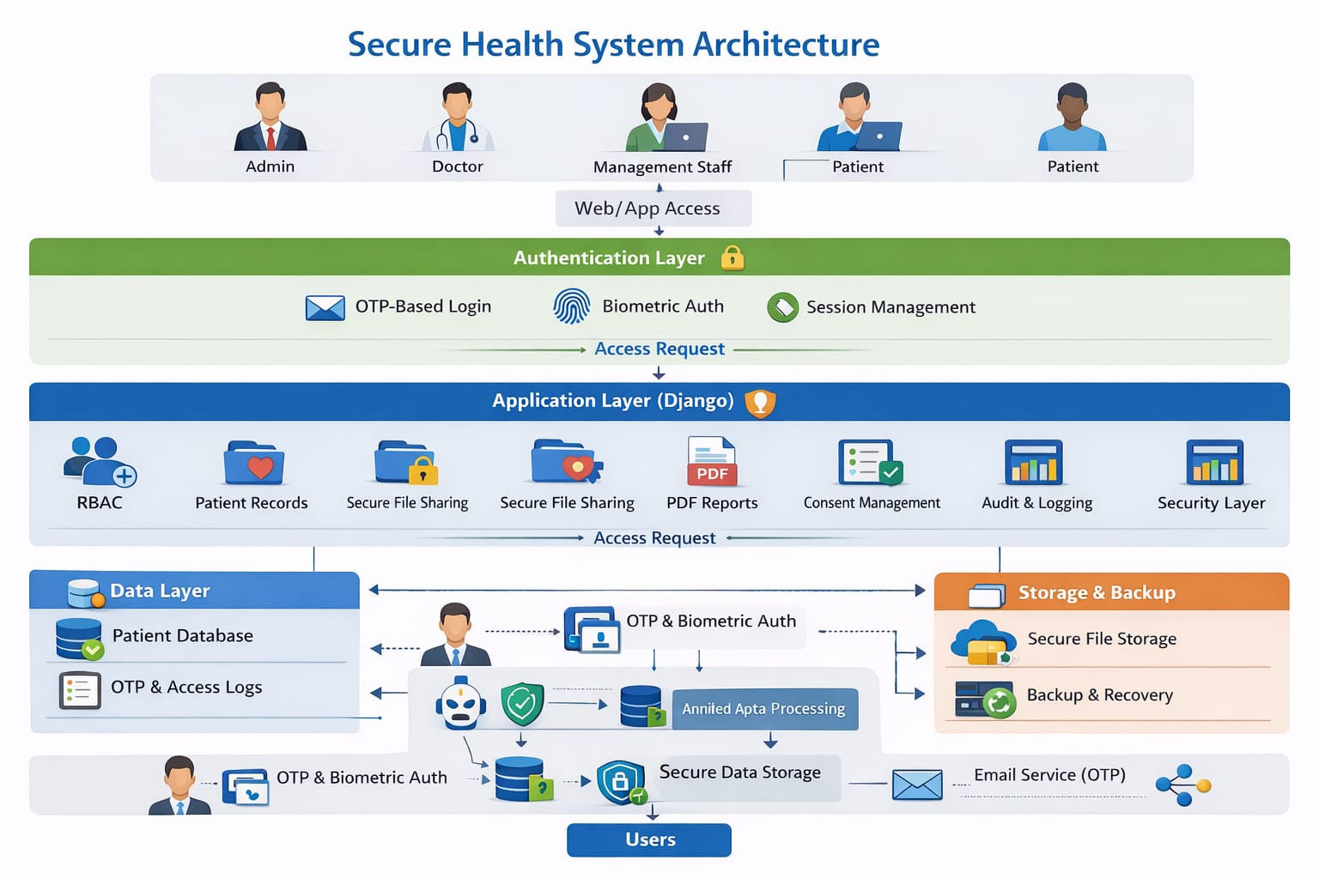
Architecture
Department of information Science and Engineering
www.cambridge.edu.in

Slide 15
THANK YOU
Department of information Science and Engineering
www.cambridge.edu.in

